Slide 1
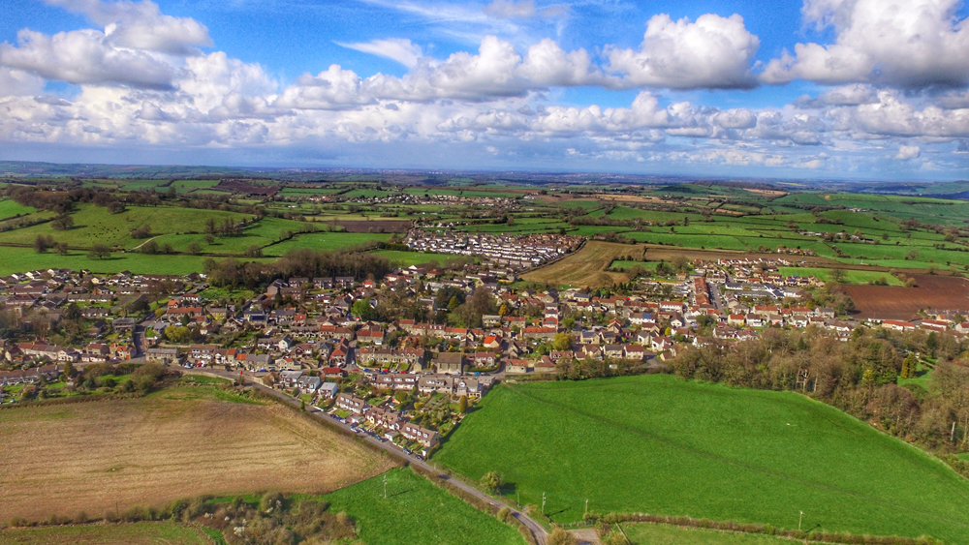
B&NES Reset Local Plan Options:
Timsbury 2025 to 2043
Timsbury Parish Council &
Cllr Shaun Stephenson-McGall

Slide 2
Briefing agenda
B&NES Reset Local Plan Options
Timsbury 2025 to 2043
www.bathnesplaces.co.uk/localplan
Introductions & background
What is the Local Plan?
Issues, Challenges and Spatial Priorities
Key Requirements
Spatial Strategy
Bath, Bristol to Bath corridor, and the Somer Valley
Rural Area
Timsbury
Context
Site Options & Opportunities
Constraints & Mitigation
Further Evidence Required
Somersetshire Coal Canal & other planning issues
Have your say and future timeline

Slide 3
Introductions & background
B&NES Reset Local Plan Options
Timsbury 2025 to 2043
www.bathnesplaces.co.uk/localplan
Introductions
Timsbury Parish Council Local Plan Working Group
Members
Cllr KC Bradley (Chair)
Cllr Mark Foster (Vice-chair)
Cllr Mary-anne Ansell
Cllr David Collet
Cllr Shaun Stephenson-McGall
Remit and activity
Reports to the full Parish Council
Responded to the earlier B&NES consultation on the Local Plan (2022-2024)
Received training by B&NES Officers to assess the “Housing and Economic Land Availability Assessment” sites in the Parish

Slide 4
What is the Local Plan? (448 page document!)
B&NES Reset Local Plan Options
Timsbury 2025 to 2043
www.bathnesplaces.co.uk/localplan
Strategy framework for how B&NES will change and grow over the next 15-20 years.
It sets out planning policies that will be the basis for how future planning applications are decided.
Identifies the need for new homes and jobs together with the services and infrastructure required up-front to support them.
Maintain and create sustainable, vibrant and healthy places and communities.
Without a local plan, speculative development will take place in less sustainable areas, and in an unplanned way.
It will be reviewed around every 5 years and updated where necessary.
Previously B&NES planned for c.700 homes per year, but Government over doubled this to c.1,500 homes per year.
Therefore B&NES has reset the local plan so gather further evidence work and assess new options to meet new targets
Not all of these options will be taken forward for allocation for development in the Draft Local Plan.
Notes:
The strategy and framework for how B&NES will change and grow over the next 15-20 years.
It sets out planning policies that will shape any development that requires planning permission.
The plan identifies the need for new homes and jobs, and the services and infrastructure required up-front to support them.
It provides strong guidance to developers and the council on where this development should happen and what form it will take.
It is about ensuring that we maintain and create sustainable, vibrant and healthy places and communities.
Without a local plan, speculative development will take place in less sustainable areas, and in an unplanned way.
The basis for how planning applications for new development are decided.
The local plan will be reviewed around every 5 years and updated where necessary.
Previously B&NES planned for around 700 homes per year.
Government imposed a new mandatory housing target of around 1,500 homes per year.
Therefore B&NES decided to reset the local plan so that it could undertake further evidence work and assess further options for providing increased levels of development
The Options Document primarily focusses on options for providing the additional development now required.
Not all of these options will be taken forward for allocation for development in the Draft Local Plan.

Slide 5
Issues, Challenges and Spatial Priorities
B&NES Reset Local Plan Options
Timsbury 2025 to 2043
www.bathnesplaces.co.uk/localplan
Housing Affordability and the Economy
High house prices is exacerbated by average median workplace wages
Lack of affordable housing
Insufficient supply of employment land
Climate and Ecological Emergencies
Increased frequency of flooding, overheating, and extreme weather events
Health and Well-Being
B&NES is one of the least deprived local authorities in the country (269 out of 317 for overall deprivation)
But rural poverty is growing
Large numbers (children & adults) are physically inactive
Transport and Connectivity
Bus services in rural areas are dependent on external funding, which is subject to ongoing review and cannot be guaranteed over the plan period
Culture and Community Identity
Community identity and local distinctiveness is a key challenge

Slide 6
Key Requirements
B&NES Reset Local Plan Options
Timsbury 2025 to 2043
www.bathnesplaces.co.uk/localplan
Job growth and employment land
New housing (27,000) to address population growth and needs of different groups
Measures to help tackle the climate & biodiversity emergency
Facilitate nature recovery and enhancement
Role places can have influencing health and wellbeing outcomes
Transport which makes the district more sustainable through public transport and active travel (walking, cycling and wheeling)

Slide 7
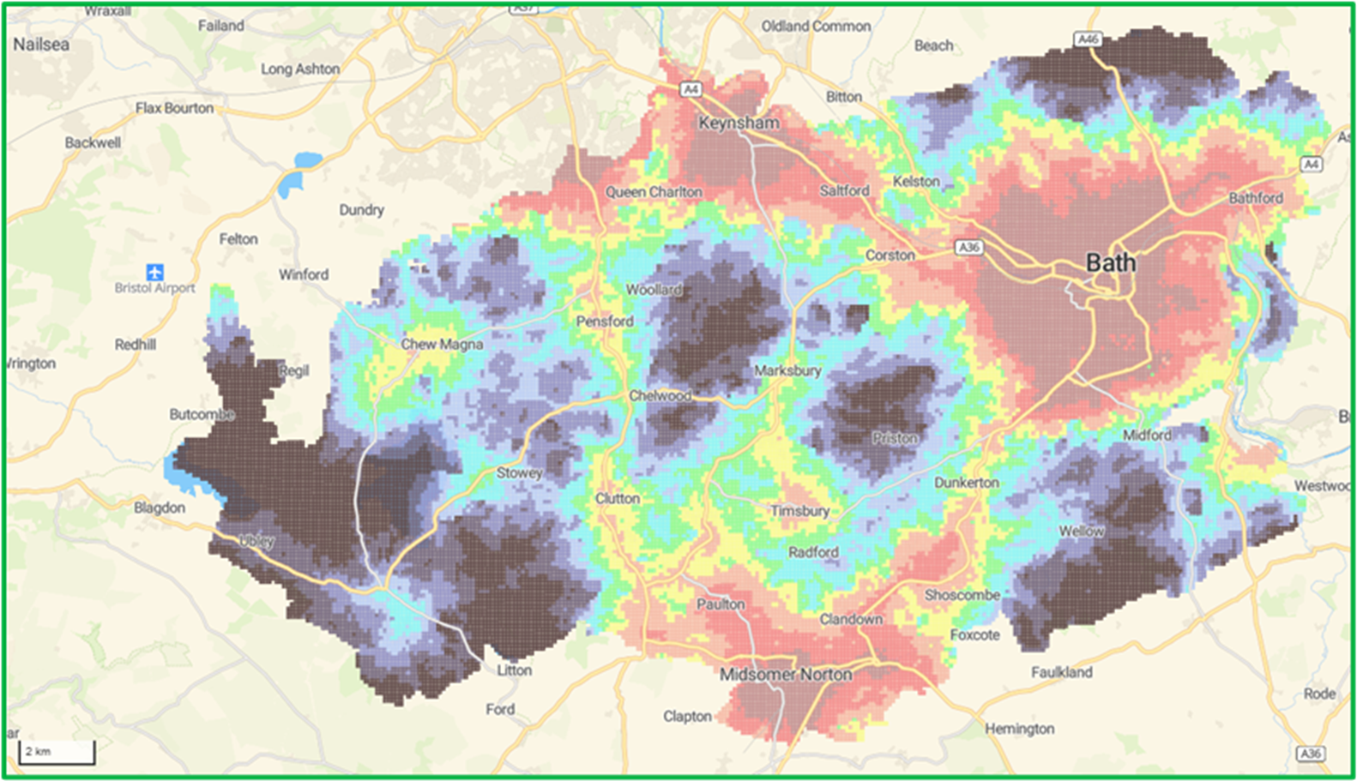
Spatial Strategy
B&NES Reset Local Plan Options
Timsbury 2025 to 2043
www.bathnesplaces.co.uk/localplan
Map 4: Relative sustainable transport connectivity across B&NES (Page 48)

Slide 8
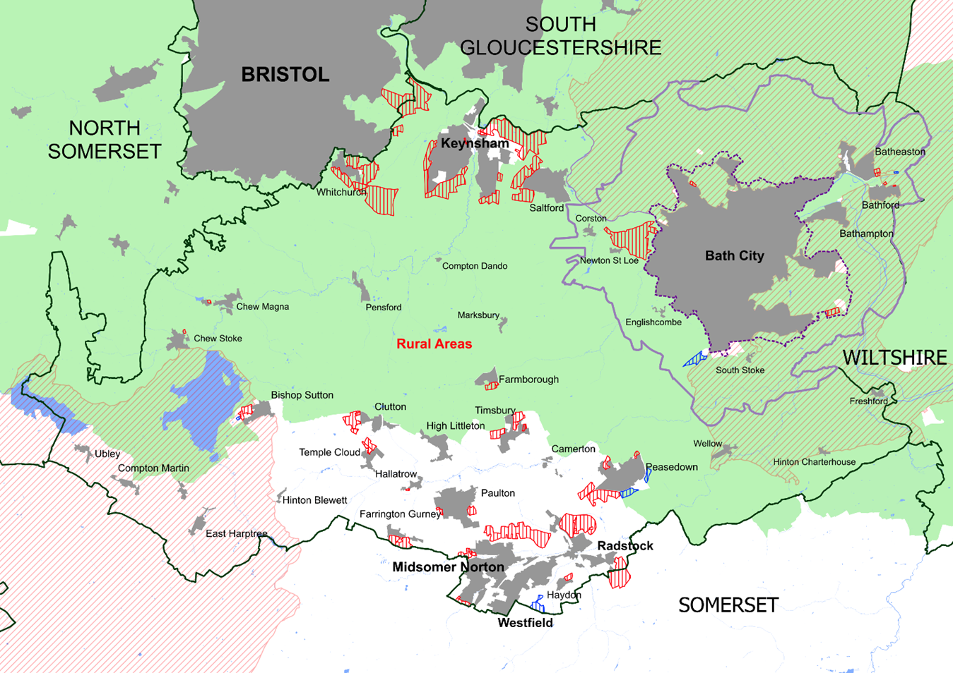
Bath, Bristol to Bath corridor and the Somer Valley
B&NES Reset Local Plan Options
Timsbury 2025 to 2043
www.bathnesplaces.co.uk/localplan
Map 9: Map showing locations of strategic site options (Page 68)
(Bath: c.6K to 7K; Bristol to Bath corridor c.10.5k to 13.2k; Somer Valley c.6.5k to 7.5k, and Rural c.1.7k to 3.0k)

Slide 9
Rural Area
B&NES Reset Local Plan Options
Timsbury 2025 to 2043
www.bathnesplaces.co.uk/localplan
37,000 people
Traditional rural economy limits growth potential
Poor public transport and digital connectivity
78% of rural residents commute to work by car
The lack of affordable housing threatens the vitality of local businesses and the social sustainability of villages.
While proportionality remains a guiding principle, there is now a need to consider whether some comparatively sustainable rural locations may be suitable for larger-scale development.

Slide 10
Timsbury: Context
B&NES Reset Local Plan Options
Timsbury 2025 to 2043
www.bathnesplaces.co.uk/localplan
One of the larger and more sustainable villages
Benefits from a broad range of services and facilities, including a primary school, local shops, and community amenities.
Moderate connectivity score and serves as a local hub for surrounding rural communities.
Infrastructure constraints include limited GP provision and a cemetery that is nearing capacity.
Transport issues associated with North Road, which would need to be addressed as part of any future growth strategy.

Slide 11
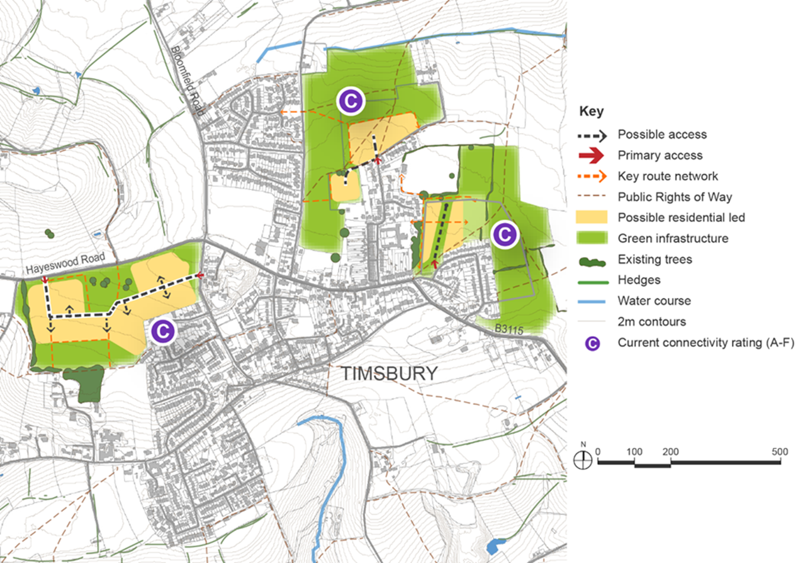
Timsbury: Site Options
B&NES Reset Local Plan Options
Timsbury 2025 to 2043
www.bathnesplaces.co.uk/localplan
Figure 75: Timsbury site options (Page 375)

Slide 12
Timsbury: Site Options & Opportunities
B&NES Reset Local Plan Options
Timsbury 2025 to 2043
www.bathnesplaces.co.uk/localplan
Existing site: East of St. Mary’s School / Lansdown Crescent
Currently allocated 20 homes
Potential capacity of 50-70 homes
New site: Lippiatt Lane and Crocombe Lane
Potential capacity of 70-90 homes
New site: Emlett Field / Hayeswood Road
Opportunity to test the potential for larger scale growth
Promoted for 120 homes
Potential capacity of 160 to 220 homes
Potential for larger-scale growth to support infrastructure and services

Slide 13
Timsbury: Constraints & Mitigation
B&NES Reset Local Plan Options
Timsbury 2025 to 2043
www.bathnesplaces.co.uk/localplan
Constraints
Conservation Area
Limited GP provision
Cemetery nearing capacity
Public transport / Buses
Transport issues on North Road
Narrow access to Lippiatt Lane and Crocombe Lane
Landscape sensitivity and key views
Primary School
Connectivity (DfT A-J: Timsbury sites are C. (A is highest))
Mitigation
Infrastructure planning to address healthcare and burial capacity
Transport improvements, particularly on North Road
Sensitive design to protect key views

Slide 14
Timsbury: Further Evidence Required
B&NES Reset Local Plan Options
Timsbury 2025 to 2043
www.bathnesplaces.co.uk/localplan
Landscape and visual impact assessment
Transport and access feasibility
Cumulative impact assessment of both new sites in addition to existing site

Slide 15
Somersetshire Coal Canal (Policy HD/SCCW)
B&NES Reset Local Plan Options
Timsbury 2025 to 2043
www.bathnesplaces.co.uk/localplan
Important linear historic asset
Feedback from previous consultation in Spring 2024:
Revitalisation Support vs. Opposition
Preservation of Heritage vs. Modern Development Concerns
Economic and Community Benefits vs. Property and Environmental Concerns
Recreational Use and Access vs. Loss of Privacy and Tranquillity
Nature Conservation and Biodiversity vs. Construction and Expansion Drawbacks
Public Engagement and Communication vs. Perceived Exclusivity

Slide 16
Somersetshire Coal Canal (Policy HD/SCCW)
B&NES Reset Local Plan Options
Timsbury 2025 to 2043
www.bathnesplaces.co.uk/localplan
Proposed Policy Approach (Protection of the route):
Retain the existing adopted policy HE2, and the protected route currently shown on the policies map
Option for consultation (Restoration/ Creation):
Development of a separate policy option which seeks restoration / creation of a diverted route (that will be displayed on the Policies Map).

Slide 17
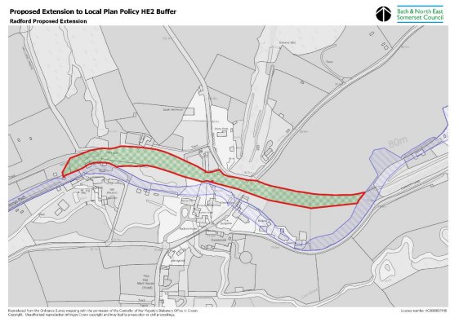
Somersetshire Coal Canal (Policy HD/SCCW)
B&NES Reset Local Plan Options
Timsbury 2025 to 2043
www.bathnesplaces.co.uk/localplan
(Figure 77 – Radford) (Page 442)

Slide 18
Other planning issues
B&NES Reset Local Plan Options
Timsbury 2025 to 2043
www.bathnesplaces.co.uk/localplan
Affordable Housing
Co-living schemes
House of Multiple Occupation
Purpose built student accommodation
Gypsies, Roma, Travellers and Travelling Show People
Housing Development Boundaries (HDBs)
Retrofit First
District Heating
Renewable Energy
Low Impact Farming
Biodiversity Net Gain
Green Infrastructure
Landscape Character
Green Belt
Undesignated Industrial sites Policy
Cultural Infrastructure
Local Green Spaces
Waste

Slide 19
Have your say
B&NES Reset Local Plan Options
Timsbury 2025 to 2043
www.bathnesplaces.co.uk/localplan
Direct to B&NES online: www.bathnesplaces.co.uk/localplan
Between 3rd October and 14th November 2025
Respond to the Village Housing Survey
By Friday 24th October 2025
Ward Councillor submission online to B&NES
Parish Council submission online to B&NES
Signed-off at Parish Council on Monday 3rd November 2025

Slide 20
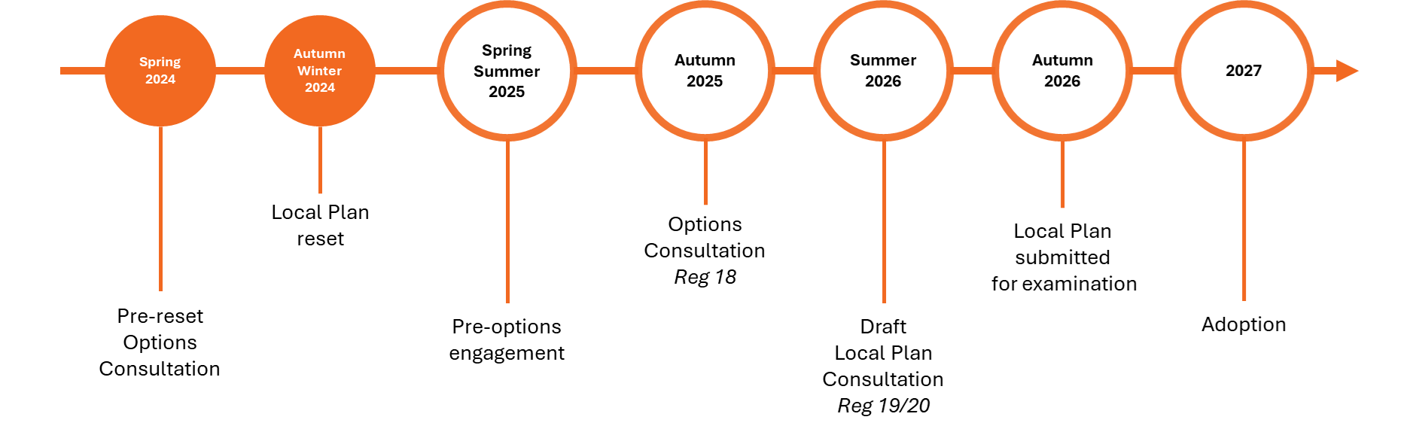
Future timeline
B&NES Reset Local Plan Options
Timsbury 2025 to 2043
www.bathnesplaces.co.uk/localplan

